Slide 1
Databases Final Project Course - 10127
Gilad Faibish – ID 316566892
Emil Glater – ID 206750705

Slide 2
General Description
Java Program Description
The original Java program is a system designed to generate exams for various purposes, including academic assessments, job interviews, and polls. Additionally, the system is capable of generating multiple databases, each containing a collection of questions, answers, and exams specific to a particular subject.

Slide 3
General Description
System Functionality
Upon logging into the system, users are prompted to choose between creating a new database or accessing an existing one. Once a selection is made, a window with a variety of options is presented. Users can add questions (open-ended or multiple-choice) and answers to the database. For open-ended questions, users are required to link an answer from the database to the question, which cannot be modified afterward. In the case of multiple-choice questions, answers are linked individually, and users have the option to remove any answer from a multiple-choice question or delete any type of question from the database.
The system also provides the functionality to view all stored questions and their corresponding answers.

Slide 4
General Description
Exam Creation
The system allows users to create exams either automatically or manually using the stored questions and answers. In automatic generation, users specify the number of questions, and the system randomly selects questions and answers. For manual creation, users specify the number of questions, view all available options, and select the desired ones. For multiple-choice questions, at least four of their related answers must be selected. Once the exam is created, the system generates two files: Questionnaire – includes questions and answers (excluding truth values). Solution – includes questions and correct answers (including model answers for open-ended questions).

Slide 5
Requirements for the System
The PostgreSQL database will serve as the central repository for storing and managing the data required by the exam generation system. Specifically, the database will support the following functionalities:
Storage of Questions and Answers The database will store all questions and answers, including both open-ended and multiple-choice formats. Each question and its associated answers will be organized in a way that allows for easy retrieval, modification, and deletion.

Slide 6
Requirements for the System
Exam Generation and Storage When an exam is created, either manually or automatically, the exam data, including the selected questions and answers, will be stored in the database. This allows for exams to be retrieved, reviewed, and re-used in the future.
Data Integrity and Consistency The database will enforce data integrity, ensuring that questions are linked to the correct answers and that exams are generated with accurate information.
Backup and Recovery By using PostgreSQL, the local system can leverage robust backup and recovery features, ensuring that all data is securely stored and can be recovered in case of any system failures.

Slide 7
Requirements for the System
Scalability and Flexibility The database will be designed to handle a growing amount of data as more questions, answers, and exams are added over time.
By integrating PostgreSQL with the Java program, the system will achieve a more structured, scalable, and reliable solution for managing exams, questions, and answers, while also improving the overall performance and maintainability of the system.

Slide 8
User of the System
The system is designed to accommodate different types of users, each with their own roles and responsibilities:
System Administrators and Developers System administrators have the highest level of access, allowing them to create and manage databases, configure system parameters, and ensure the security and integrity of the data. They are responsible for the development, optimization, and maintenance of the database. They may also handle backup and recovery tasks and troubleshoot any system issues.

Slide 9
User of the System
Instructors and Educators Instructors can create, edit, and delete questions and answers in the database. They also generate exams, either automatically or manually, for their students. Additionally, they can review and select questions from the database to tailor exams to specific learning outcomes.
HR Professionals and Interviewers HR professionals use the system to create job-specific assessments. They can select questions from a database tailored to various skills and knowledge areas, ensuring that the exams meet the requirements of the job positions they are recruiting for.

Slide 10
User of the System
Survey Designers and Poll Creators Survey designers can utilize the system to create polls and surveys. They can input questions and possible responses into the database, design surveys that suit their research needs, and manage the collected data.
By accommodating these diverse user roles, the system is versatile and applicable across different domains, including education, corporate recruitment, and research.

Slide 11
Database Entities
subjecttb This table stores information about different subjects that are associated with questions, exams, and answers.
examtb This table contains information about the exams generated by the system, including the content and the associated subject.
mquestiontb This table holds the multiple-choice questions, including their text and associated difficulty level.

Slide 12
Database Entities
answertb This table contains the possible answers for both types of questions, with each answer linked to a subject and potentially to multiple questions.
mquestion_answertb This table establishes the many-to-many relationship between multiple-choice questions and their possible answers, also indicating which answers are correct.
oquestiontb This table stores the open-ended questions along with their associated subject, model answer, and difficulty level.

Slide 13
Relationships between Entities
subjecttb ↔ examtb There is a one-to-many relationship where one subject in ‘subjecttb’ can have many associated exams in ‘examtb’, but each exam is linked to only one subject.
subjecttb ↔ mquestiontb There is a one-to-many relationship where one subject in ‘subjecttb’ can have many associated multiple-choice questions in ‘mquestiontb’, but each question is linked to only one subject.
subjecttb ↔ oquestiontb There is a one-to-many relationship where one subject in subjecttb can have many associated open-ended questions in oquestiontb, but each question is linked to only one subject.

Slide 14
Relationships between Entities
mquestiontb ↔ mquestion_answerb ↔ answertb There is a many-to-many relationship between ‘mquestiontb’ and ‘answertb’, which is managed through the junction table ‘mquestion_answertb’. This table associates multiple-choice questions with multiple possible answers, indicating the correct ones.
subjecttb ↔ answertb There is a one-to-many relationship where one subject in subjecttb can have many associated answers in answerb, but each answer is linked to only one subject.
oquestiontb ↔ answertb There is a one-to-many relationship where each open-ended question in ‘oquestiontb’ is linked to one correct answer in ‘answertb'. However, an answer in ‘answertb’ might not be linked to only one open-ended question, as it could be used for multiple questions, and of different types.

Slide 15
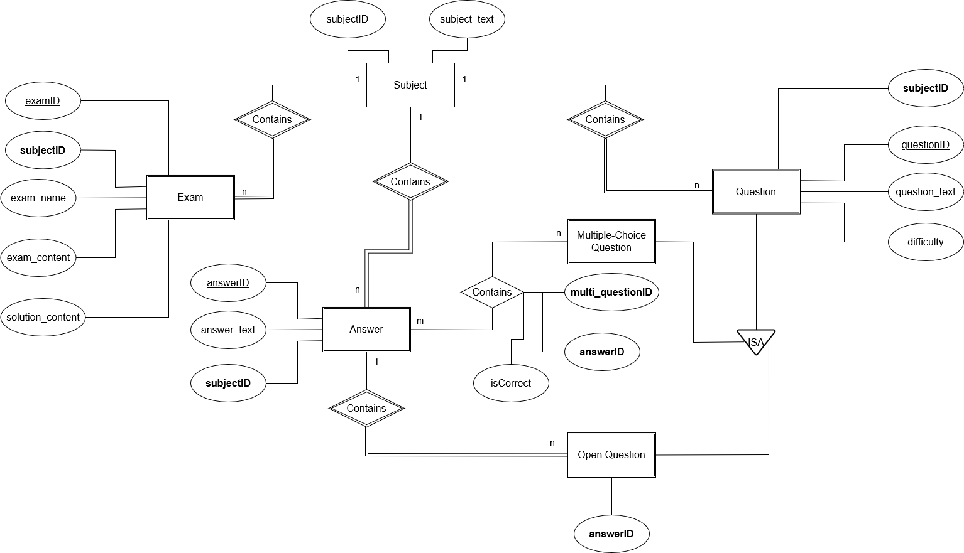
ERD

Slide 16
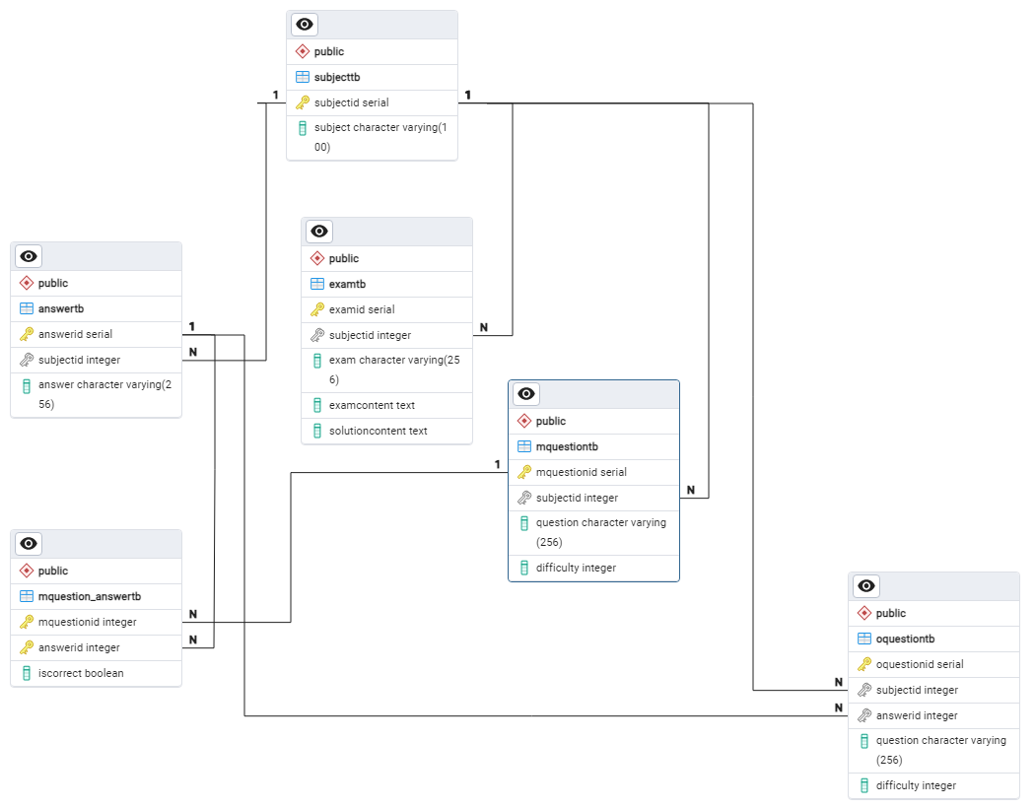
Tables

